Slide 1
Domain Adversarial Neural Networks
(DANN)
Hana Ajakan, Pascal Germain, Hugo Larochelle, Francois Laviolette, Mario Marchhand
D´epartement d’informatique et de g´enie logiciel, Universit´e Laval, Qu´ebec, Canada
D´epartement d’informatique, Universit´e de Sherbrooke, Qu´ebec, Canada
rayjang111@gmail.com
HyunSukJang

Slide 2
CONTENTS
01
02
03
04
Introduction
DANN Model Architecture
Train&test method
Evaluation

Slide 3
01
Introduction
.

Slide 4
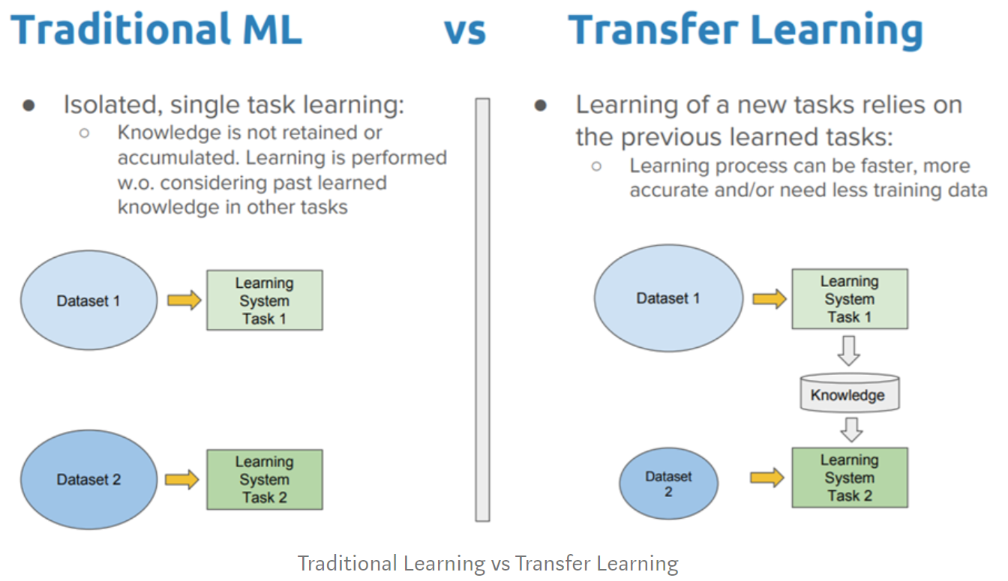
01.
Introduction
What is Adaptation learning???

Slide 5
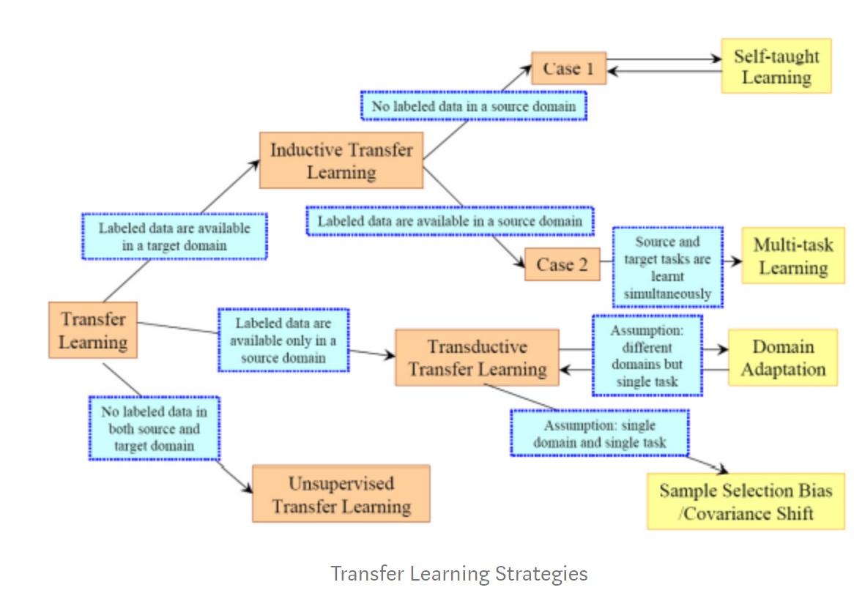
01.
Introduction

Slide 6
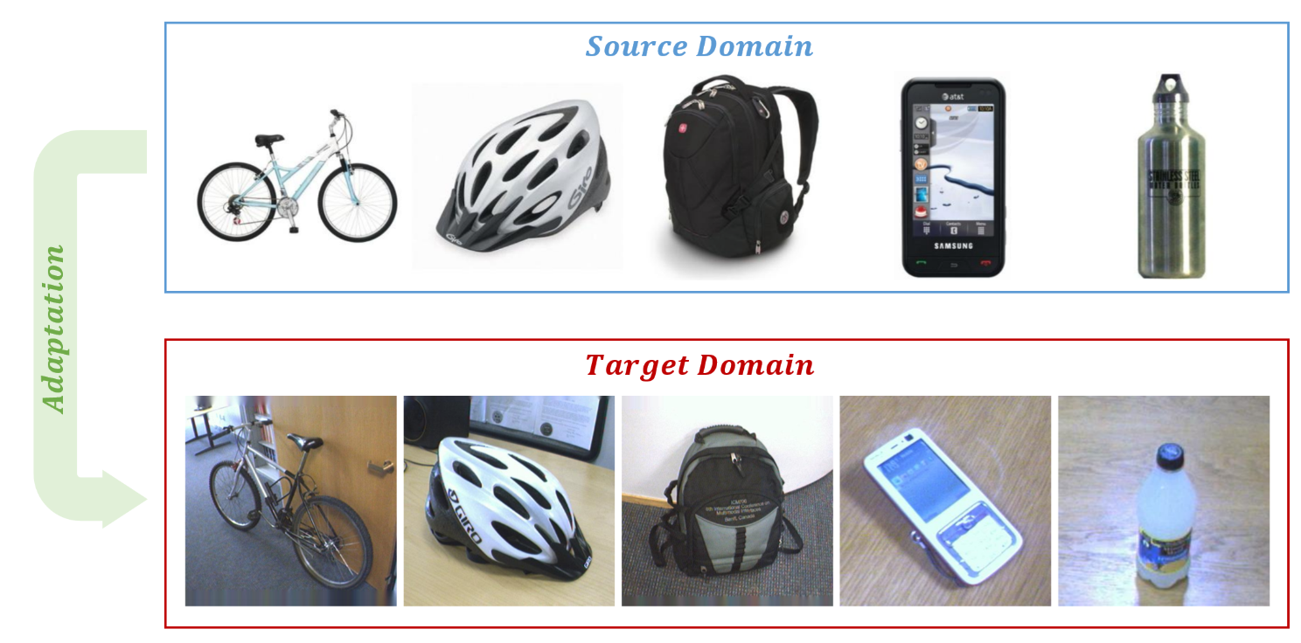
01.
Introduction

Slide 7
02
DANN Model architecture

Slide 8
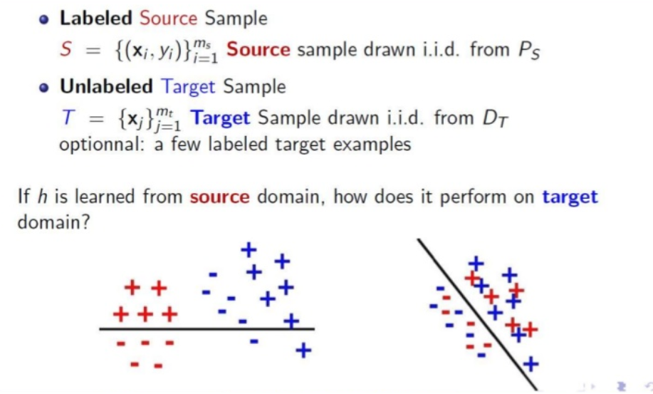
02.
DANN Model architecture

Slide 9
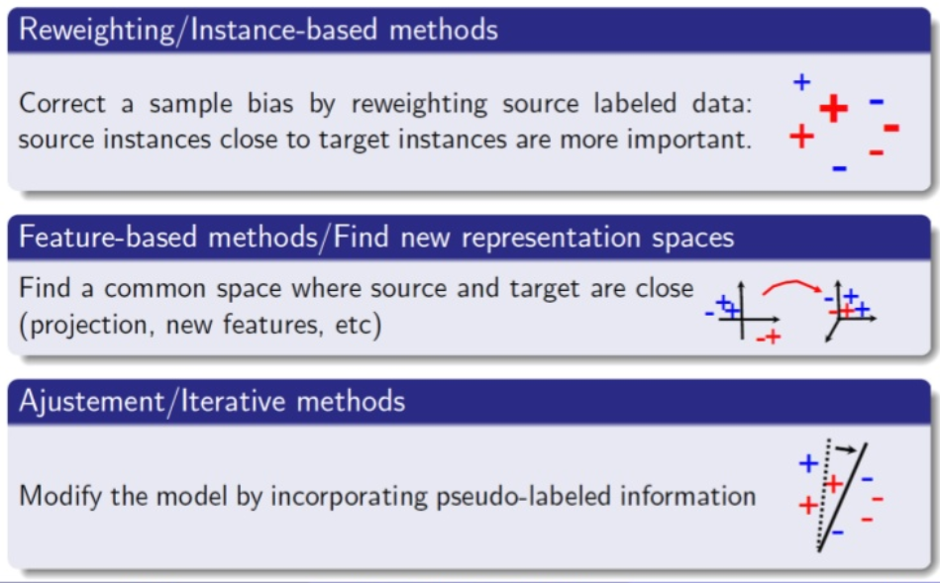
02.
DANN Model architecture

Slide 10
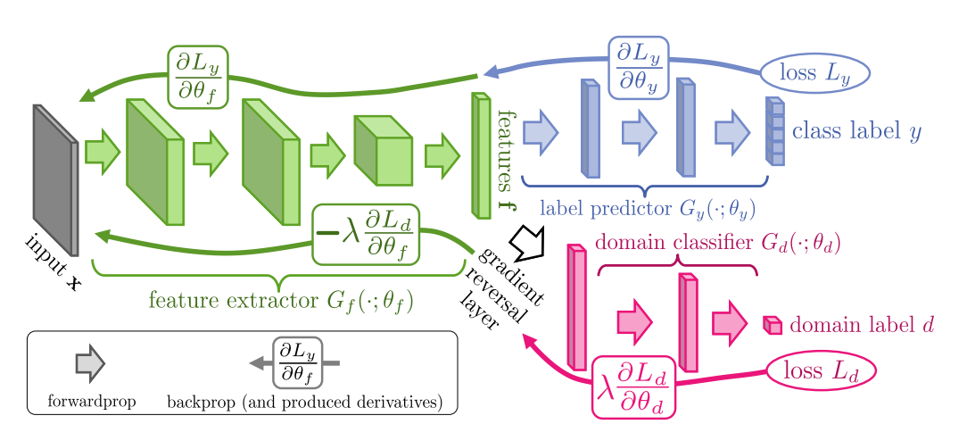
02.
DANN Model architecture

Slide 11
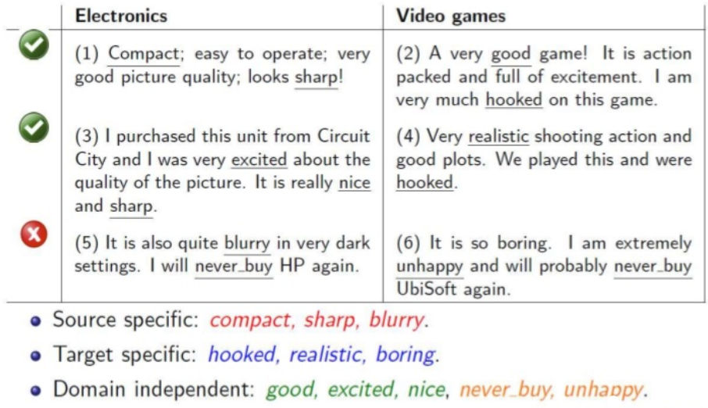
02.
DANN Model architecture

Slide 12
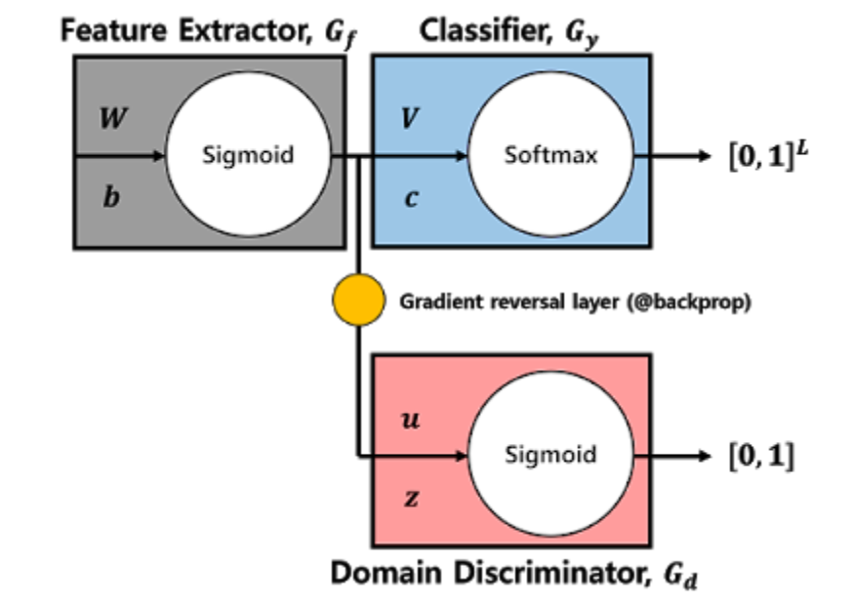
02.
DANN Model architecture

Slide 13
02.
DANN Model architecture
0:Negative
1:Positive
Ordinary Classification

Slide 14
02.
DANN Model architecture
0: Video games
1:Electronics
Domain Classification

Slide 15
02.
DANN Model architecture
By minimizing classification error of source data& divergence between source domain and target domain
=>Features will be extracted to classify both source domain and target domain
Domain Classification

Slide 16
03training&test method

Slide 17
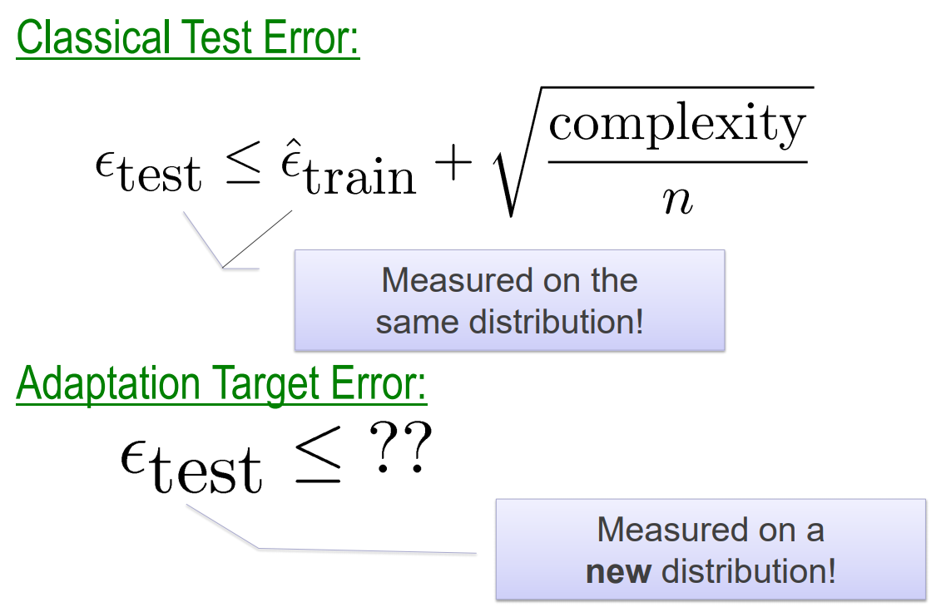
03.
training&test method

Slide 18
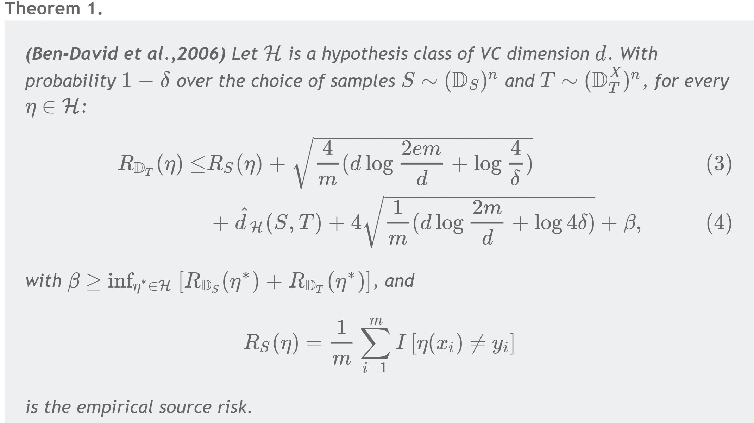
03.
training&test method

Slide 19
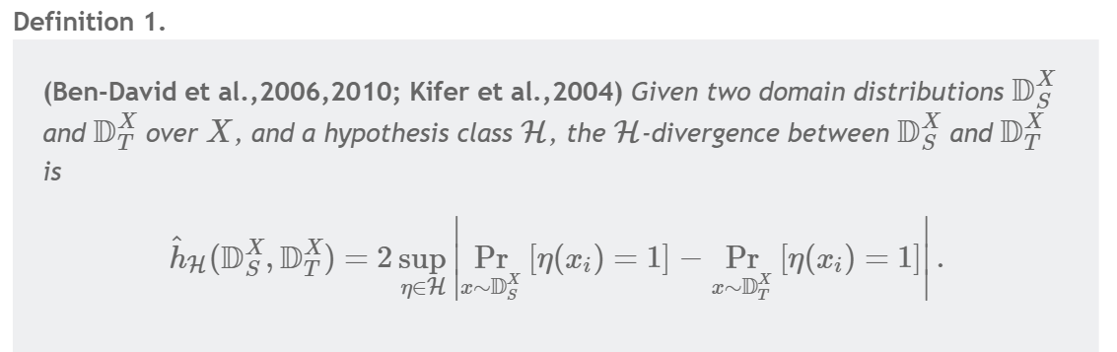
03.
training&test method

Slide 20
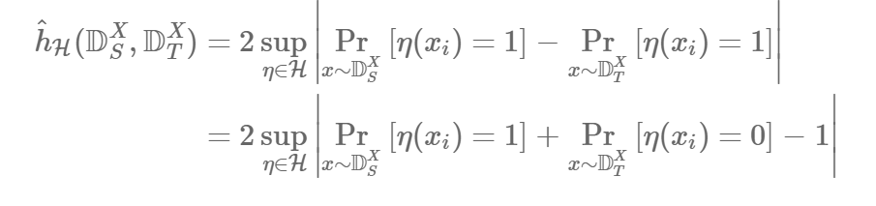
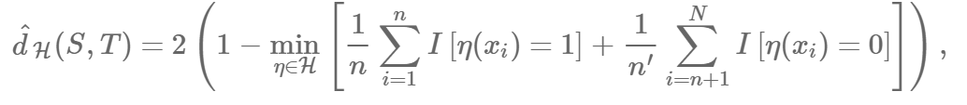
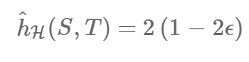
03.
training&test method

Slide 21
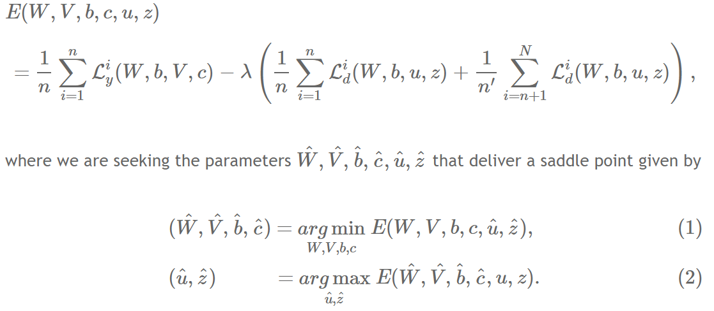
03.
training&test method

Slide 22
04 evaluation

Slide 23
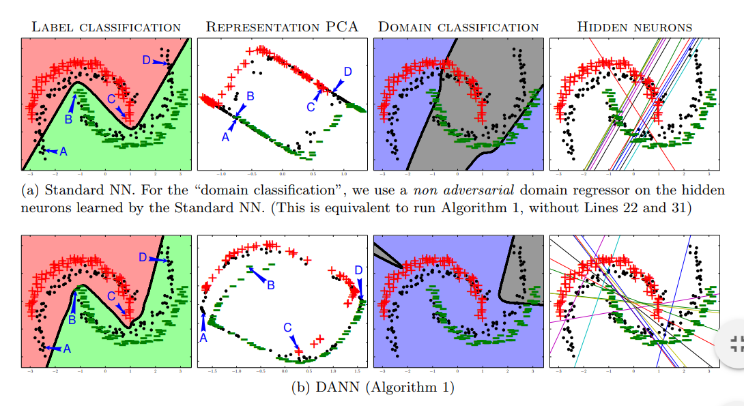
04.
evaluation
Toy problem

Slide 24
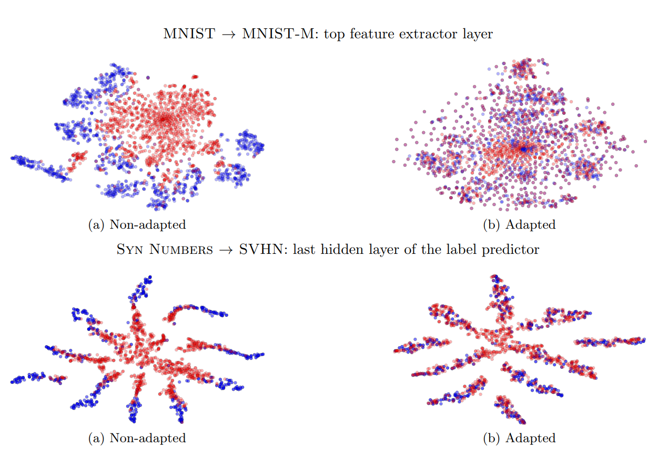
04.
evaluation

Slide 25
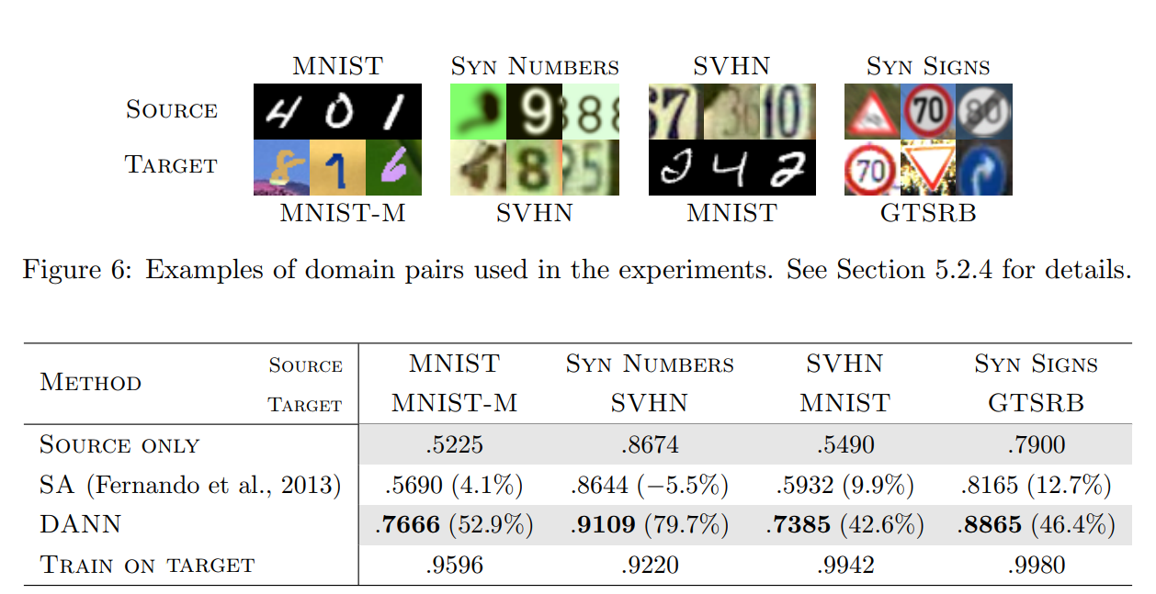
04.
evaluation

Slide 26
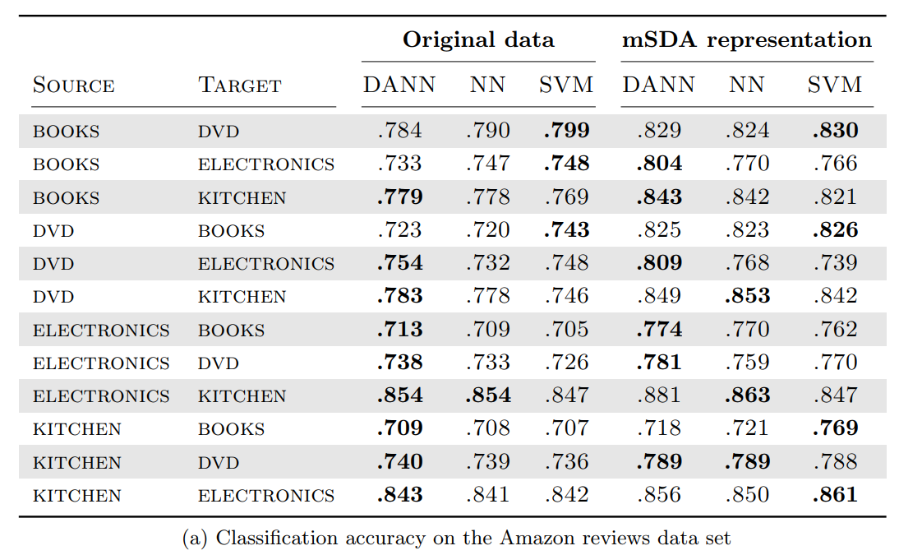
04.
evaluation

Slide 27
Thank you

